Slide 1
Dr Suzanne Smith PhD
Chief Programme Advisor/Volunteer
Dr Bryony Kendall
Named GP for Safeguarding, NHS Liverpool CCG

Slide 2
The Named GP story
Introduction
Revision of knowledge and programme
Change your practice
Notes:
For most of you this is not new information – and this is recognised
For some of you it is well established – how can we build on what you already do?
Aim to change your practice, and those of the GPs and other HCPs in your CCG
I’m going to let Sue give a bit of background then give a recent example and give examples of development ideas

Slide 3
NHSE/I
All ICS across the North and Midlands
7/8 core cities
Notes:
NHSE and I have bought lifelong licences to ICON, and are supporting the ICSs/STPs in the two large regions
Scottish borders to south of Birmingham
NB all the core cities in England except Bristol (Birmingham, Leeds, Liverpool, Manchester, Newcastle, Nottingham, Sheffield)

Slide 4
NSSG directive
Notes:
National Safeguarding Steering Group: Continue to work on ICON during covid – they deemed it very important
Hold fast – hold the rigging for your boat; “bear down and fight through the storm” – apt for covid

Slide 5
What is Abusive Head Trauma?
AKA Shaken Baby Syndrome
Child Abuse
Catastrophic injuries:
Brain injuries
Bleeding behind the eyes
Bony injuries
Causal mechanism rarely confirmed
Acceleration/deceleration
Impact
1 in 14 cases – fatal before hospital discharge
Half of severely injured survivors die before aged 21.

Slide 6
WHO SHAKES and why?
70% perpetrators are males – fathers/male surrogates (Kesler et a 2008; Altman et al 2010)
Can occur in every socio-economic group
Coping with crying: Living on the edge
Caregivers lose control and shake – baby stops crying
Some risk indicators include
financial hardship, low birth weight, prior referral to child protection services (strong risk factor) and young parents (Otterman and Palusci 2020).
The link with Adverse Childhood Experiences (ACEs): with each additional ACE, study participants were more likely to accept potentially harmful parenting behaviour. (Clemens et al 2020)

Slide 7
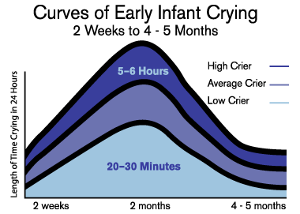
Normal Crying curve

Slide 8
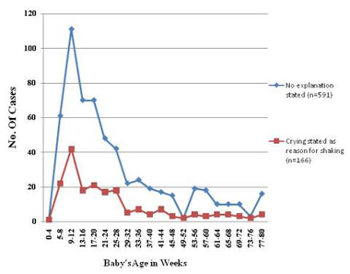
Cases of AHT

Slide 9
Notes:
Where we are up to.

Slide 10
Social Media
Between Sept 14th to Oct 5, ICON reach via social media reached 28,079
85% women, 15% men.
There is a growing engagement with men since the intensified campaign began in April 2020.

Slide 11
NHS 111
New care advice incorporating the ICON message was approved by the National Clinical Governance Group and included in infant pathways for disposition of 6 hours and longer.
Also included in relevant adult mental health pathways where the interrogation of major life events now includes a new baby for male callers as well as female.

Slide 12
Measuring impact -Hampshire
Views of professionals
2018 10% of GPs routinely asked about coping with crying.
2019 95% of GPs routinely ask about coping with crying at 6 week check and 93% that ICON helps them do that.
“There are posters everywhere and [parents] already have the leaflet by the time they reach the ward so easy to cover on postnatal ward”
“It’s second nature now if part of our discharge chat”.
“I have not had an bad responses, I find it ok”.

Slide 13
Views of parents/carers: 87% of families were aware of the ICON message and when asked 95% of parent/carers were able to confirm that they had received and remembered the messages.
When asked ‘Would you feel confident to share the advice on crying with other people who care for your baby?’ 100% of the parents and carers responded with ‘yes’.
When asked ‘After receiving the ICON information did you change your behaviour in relation to your babies crying?’, the majority replied ‘yes’.

Slide 14
Parent/Families ICON Group
Ellis’s Story
“I don’t know if anyone else feels the same but seeing it there in a newsletter, somehow feels like there’s some sort of relief/accomplishment! That make sense?”
“ICON means so much to myself and my family. Knowing we can turn a negative life changing event into something positive, is what we wanted. I’m so proud to be apart of it.”

Slide 15
Parents/Families ICON Group
“I still have to pinch myself and check ICON is real sometimes. Im so proud to be part of it, it means so much to myself and my family.. we also have an extended family now thanks to ICON.”
“ I miss Ellis every day, and hope ICON can prevent babies being shaken , and brothers being taken away as Ellis was."

Slide 16
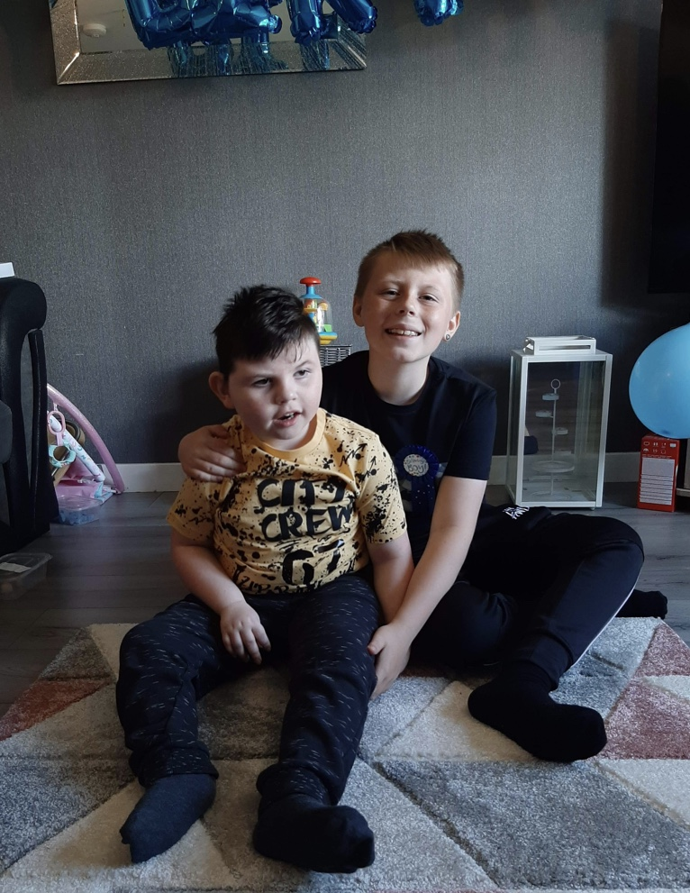
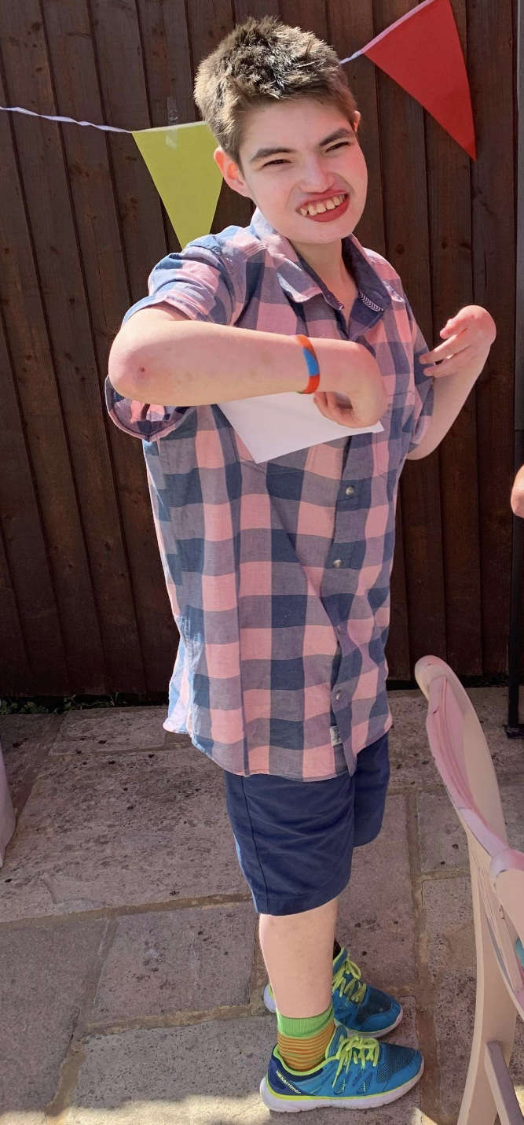
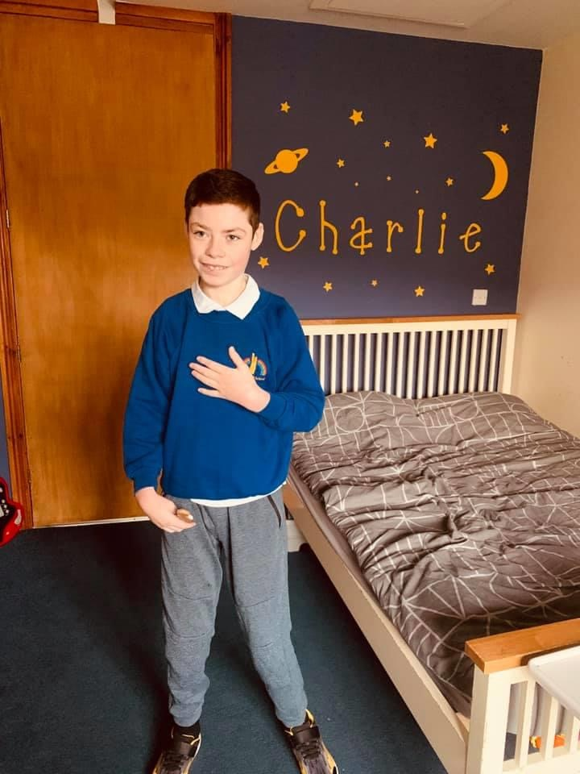
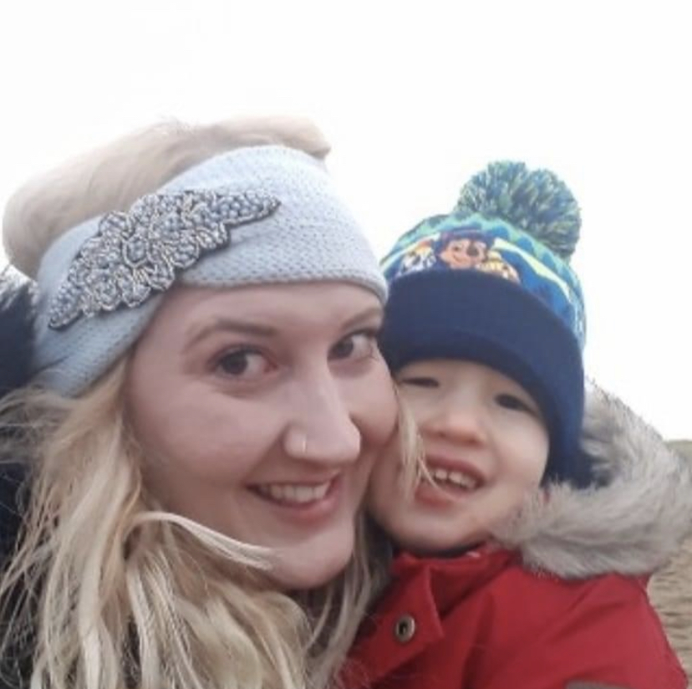
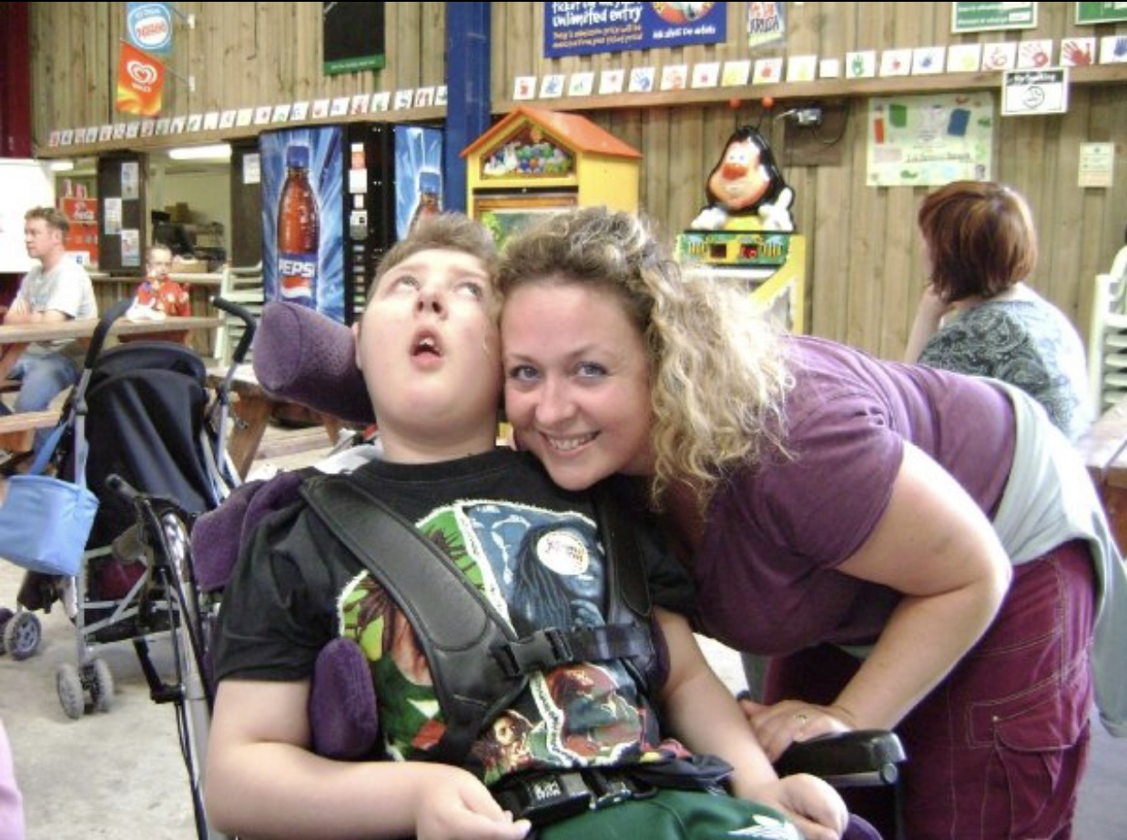
Notes:
From the parents and families of Charlie, Jason, Harvey, Jacob and Ellis.

Slide 17
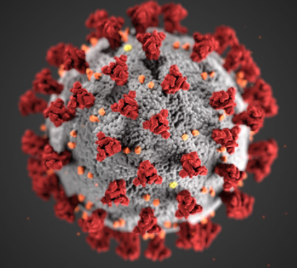
Case example

Slide 18
During lockdown
12w child “death by shaking and blunt force trauma”
Child SPR written; awaiting completion of trial process
Notes:
In this region
Anonymised as not yet published
Death by shaking and blunt force trauma, 8 posterior rib # of different ages, retinal haemorrhages and subdural haemorrhage
(SPR – safeguarding practice review – previously known as serious case reviews)

Slide 19
Hidden male
Mother attended alone due to covid restrictions
Father shared care of baby but not seen
Notes:
Family were known to services and were not hidden, good engagement with GP and surgery

Slide 20
“Was the GP aware of ICON?”
Direct questions asked regarding crying and sleep patterns
By SPR National panel and Independent chair
Notes:
Would you be able to respond for every surgery within your CCG, especially if you are in an area where this has already been launched?
Are you assured of its being embedded in every practice?

Slide 21
Change your practice
How do you ensure the message is received by fathers?
How have you made ICON Covid-appropriate?

Slide 22
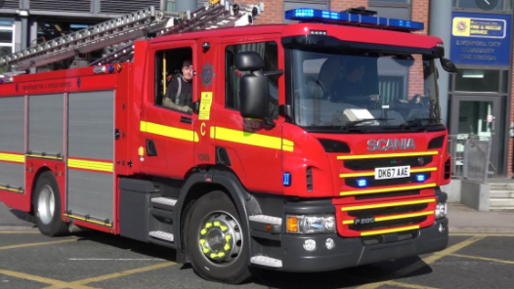
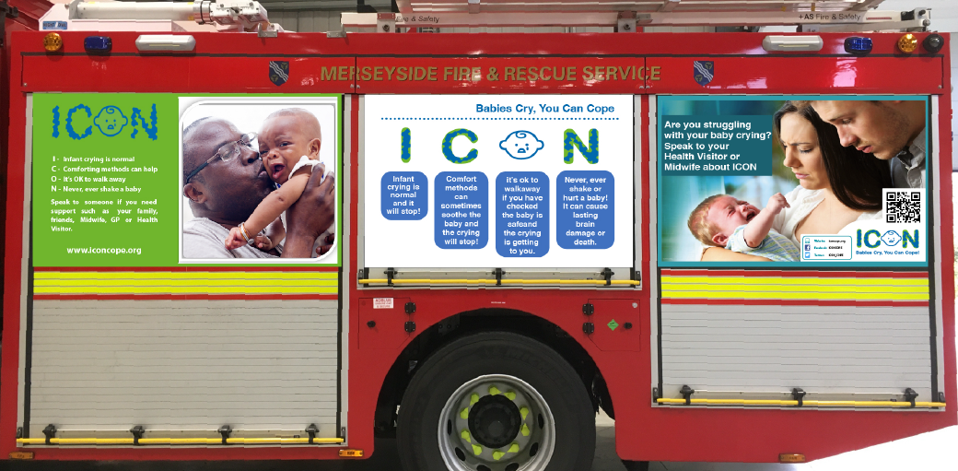
Named GP influence
Notes:
Cheshire and Merseyside are paying to put the message on two fire engines for a year (hat tip to Sefton CCGs and local authority)
Could you do something innovative and inexpensive?

Slide 23
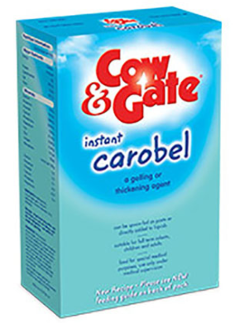
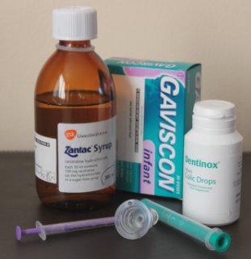
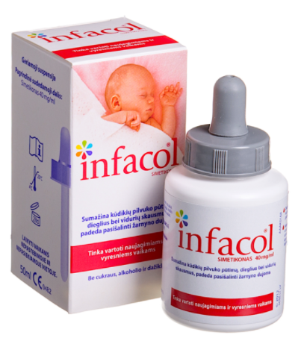
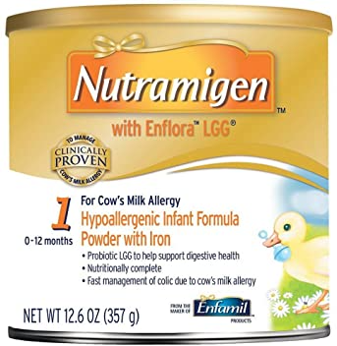
Named GP influence
Notes:
Is it reflux or is it crying? Do we take time to differentiate between the two?
Working with pharmacists – locally in the community but also within the CCG – consider prescribing infant formula and reflux Rx
(and can you work with your local hospital emergency room? Think back to the fact that the core cities are covered, and thus many of our specialist acute Trusts for maternity and paeditatrics)

Slide 24
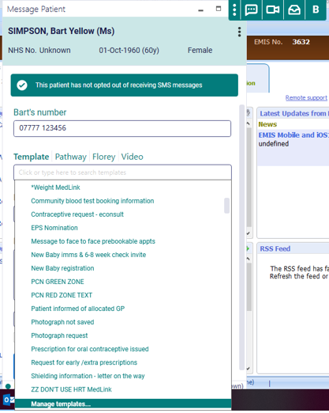
Named GP influence
Notes:
AccuRx – (age of imaginary Pt acknowledged)
Set it up within many of your templates – eg registration of baby, invite to 6w check, 8w imms etc

Slide 25
Named GP influence
Notes:
Undergraduates?
Your local medical school?
Nursing, midwifery, physician associates, doctors?
You will know GPs who teach undergraduates, foundation years, registrars…

Slide 26
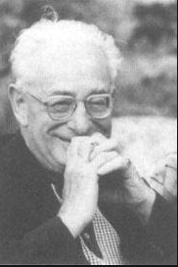
Named GP influence
Notes:
This is Michael Balint
1957: the doctor his patient and the illness
Balint introduced the concept of the doctor as a drug: remember the power you have as a GP –and even more so as a Named GP
(and not just influence for patients, but as a Named GP influence over others in health and other agencies)

Slide 27
Change your practice
Does everyone in the surgery engage and know about ICON? (patient forum?)
How have you worked with community and CCG pharmacists to think wider?
Have you thought wider still?
Notes:
From any (admittedly small number) of antenatal contacts, registration of the baby, any contacts with either parent – NOT JUST THE 6 WEEK CHECK!

Slide 28
Change your practice for ICON
Do you do it?
Do you do it consistently?
Do you review it?
Notes:
Do you do it? If not then start –engage with your local work on this, alongside the quality lead(s) in your CCG
Do you do it consistently? Does everyone in the practice do it? Robust process? Part of induction for new staff?
Do you review it? Audit? Quality assurance? PDSA cycle? Look for continuing ways to share the public health message

Slide 29
http://iconcope.org/
https://www.facebook.com/iconcope/
https://twitter.com/ICON_COPE

