Slide 1
Waste Management at Sellafield
Ciara Walsh- Waste Integration Manager, Remediation
Kirk Mayer- Policy Dept

Slide 2
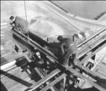
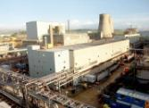
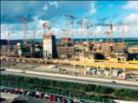
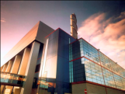
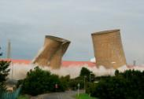
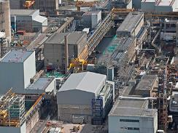
Sellafield has more than 60 years of history
1940s/50s
1960s/70s
1980s
1990s
2000s
2010s
Nuclear build begins
Initially a military programme
Later civil programme begins
Waste stored safely – pending treatment
Storage capacity extended incrementally
Coarse segregation of waste arising from process
Magnox reprocessing starts
Main expansion of site
Major waste treatment focus
Environmental impact substantially reduced
Commercialisation of reprocessing, Thorp comes online
Waste arising from processes treated in ‘real time’
Product waste forms compatible with disposal concepts
NDA formed
Stop start progress in Decommissioning
Calder Hall ceased generating power after 47 years in operation
Decision taken to end Thorp reprocessing
Vitrification of all overseas Highly Active Waste complete
Decommissioning gathering pace
First sludge exports from FGMSP

Slide 3


Our vision
Through safe and expert delivery of our mission we will be recognised as an efficient, honest and hardworking organisation that will play a significant role in Britain’s energy future.
Our strategic themes
Safe, secure site stewardship
Demonstrable progress
Return on investment

Slide 4
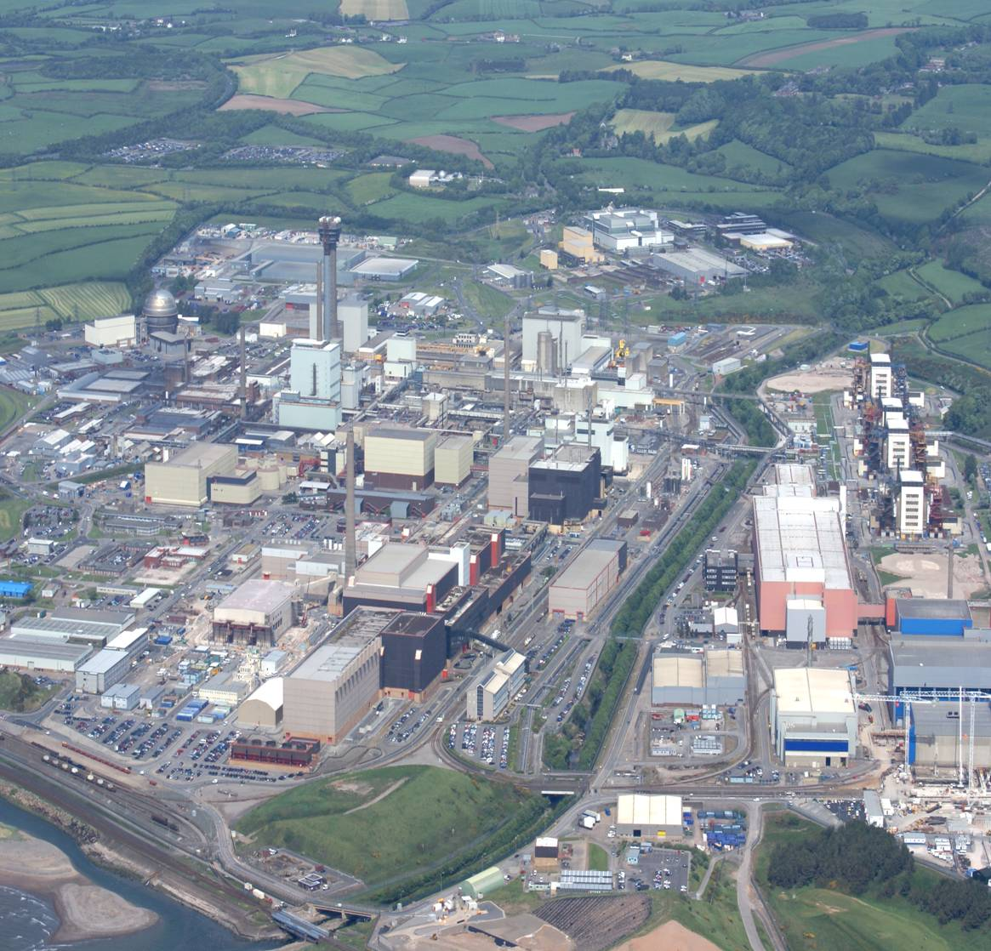
Sellafield today
2.6 km² site that contains some 2,200 buildings
170 major facilities from 60 year of nuclear industry
50,000 Te of spent nuclear fuel reprocessed
1 million m³ of concrete above the ground and 1 million m³ concrete below the ground
3,000 m³ of ILW solvent waste treated
Over 5,000 containers of vitrified HLW produced
100yr programme
55 buildings decommissioned
Entering a post-reprocessing phase

Slide 5
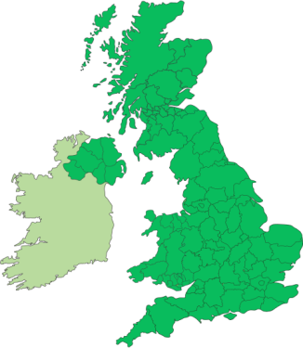
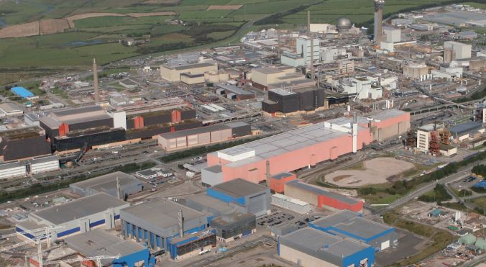
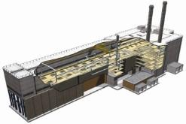
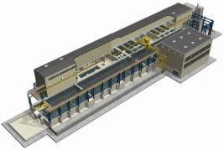



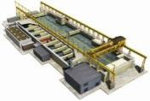
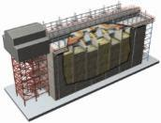
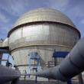

Post reprocessing at the Sellafield site
Waste Retrieval
Remediation
Pile Fuel Storage Pond
Pile Fuel Cladding Silo
Magnox Swarf Storage Silo
First Generation Magnox Storage Pond
Waste Management
Notes:
5

Slide 6
Future Scope

Slide 7
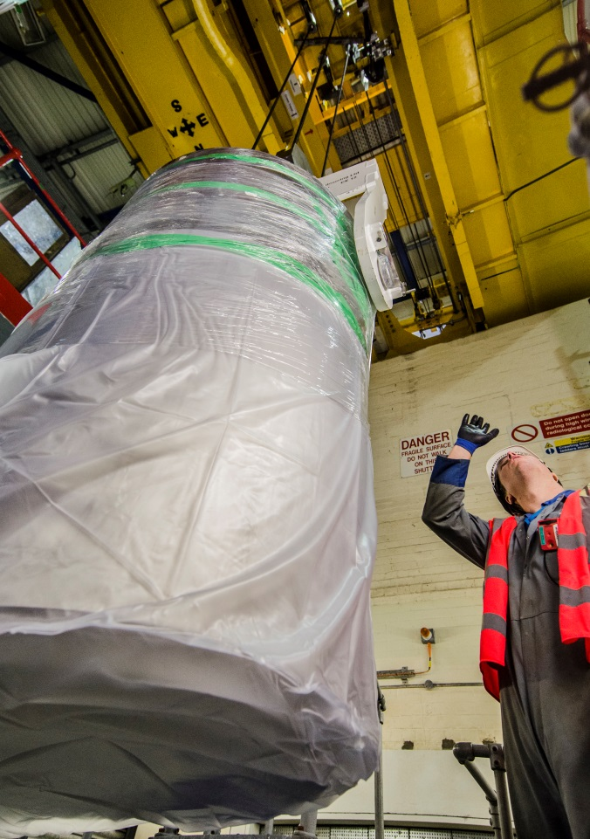
Retrieval of wastes from high hazard legacy facilities
NDA’s no.1 priority for site
£400m per year mission (a fifth of entire Sellafield Ltd budget)
Retrieval operations to be fully underway across all 4 ponds and silos by 2020
New era of getting legacy fuel and waste into a safer place

Slide 8
Remediation
Waste Management
Integrated Wastes and Decommissioning Strategy Development
POCO
Safe Stewardship
Decom
Demolition
Land Remediation
Notes:
y.

Slide 9
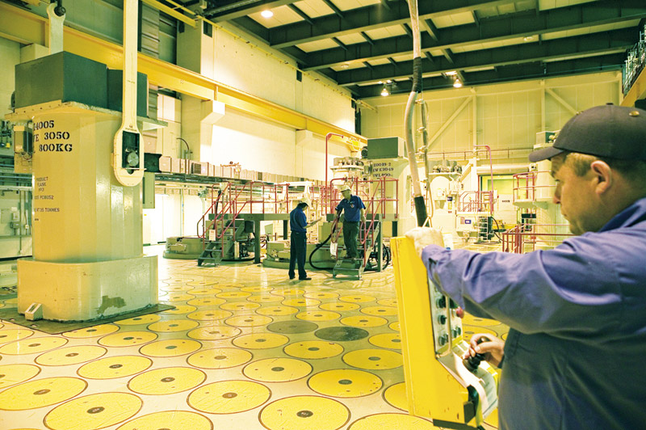
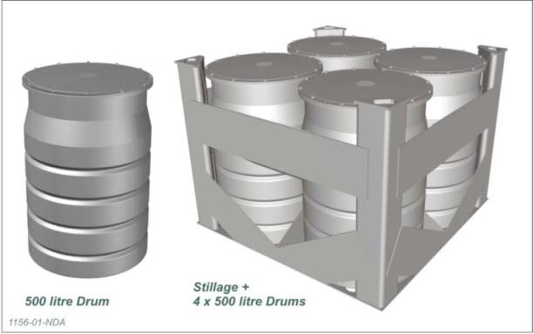
Integrated Waste Management Strategy
Understand the arisings and therefore the options
Consider the impacts on
  High hazard and risk reduction
  Environment
  Radiological dose
  Costs
Legacy waste retrievals
  We have continued to seek the best available approach
Spent fuel is not categorised as waste in the UK
  Reprocessing waste handled in near real time
Potential for significant and targeted innovation
  Challenge the paradigm
  Technically rigorous solutions
  Commanding broad support from Regulators and key stakeholders

Slide 10
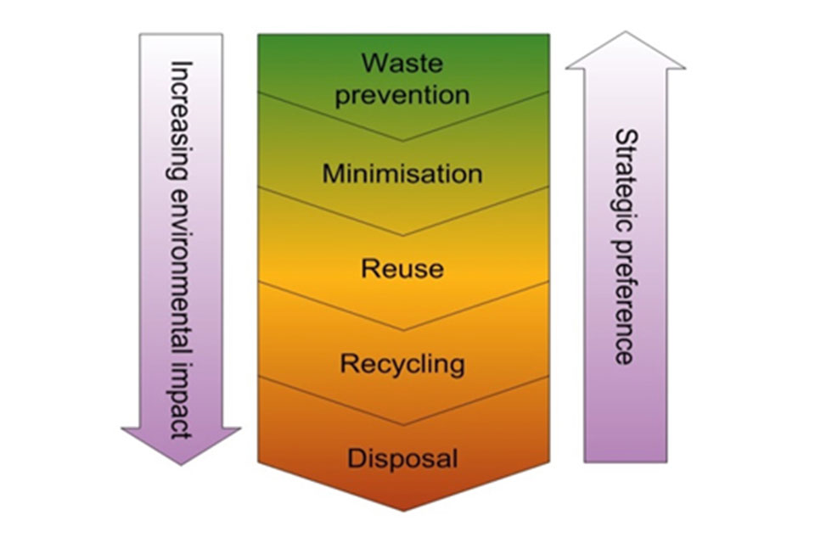
Waste Management Hierarchy

Slide 11
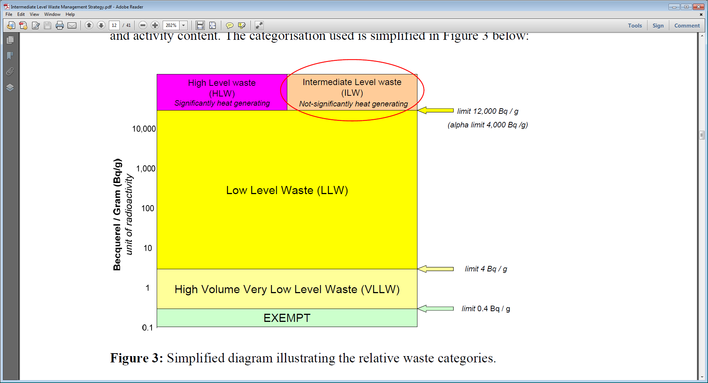
All wastes require management to final disposition

Slide 12
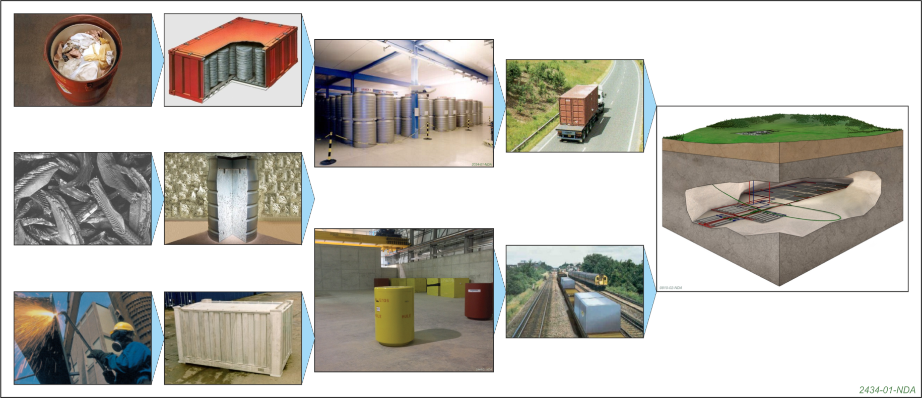
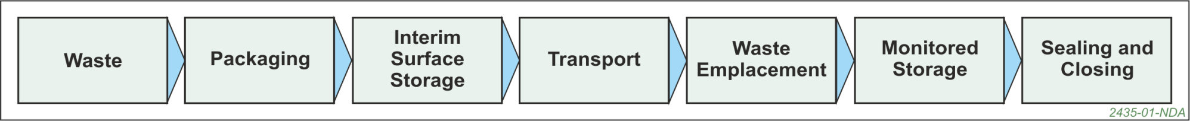
Stages in ILW/HLW Radioactive Waste Management
?

Slide 14
Planning Authority Co-Operation
Cumbria County Council for waste related issues
Copeland Borough Council for industrial activities
SL aims for a ‘no surprises’ approach
A Planning Performance Agreement is in place
Quarterly overview meetings and site visits
Application specific meetings and visits as required
Master planning capability in place at SL to bring focus to spatial planning and land allocation

