Slide 1
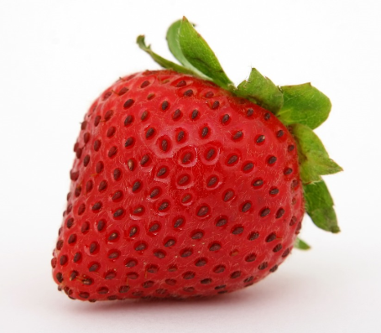
Notes:
Why have all the symbols been put in the bin?
If you let food go to waste then you not only throw away the food but all the time, energy and money spent on producing it will also be wasted.
How would you feel if you spent ages writing a story and drawing the pictures for some one to quickly look at it – not read it properly then put in the bin? I think you would feel pretty under valued?

Slide 2
What energy has been used?
Fuel – to drive lorry or tractor
Energy from the sun – to grow plants
Human energy and time spent - to pick the strawberries
Packaging – energy to make that
Cooler – keeping food fresh in transit needs energy
Human time and energy to display food in the shops
Money spent on buying the strawberries
Electricity at home to power the fridge to keep the strawberries fresh

Slide 3
Correct place to store food
Biscuit - Sealed box
Cheese - Fridge or freezer
Eggs - Fridge
Oranges - Fruit bowl
Yoghurt - Fridge
Cooked Pizza - Fridge & cling film
Ice Cream - Freezer
Crisps - Cupboard
Frozen Pizza – Freezer
Milk - Fridge or freezer

Slide 4
Correct place to store food
Tomato - Fridge
Chicken - Fridge & sealed container
Bread - Bag & clip
Beans - Cupboard
Bacon - Fridge
Bananas - Fruit bowl
Pasta - Cupboard
Apples - Fridge
Grapes - Fridge or freezer

Slide 5
Notes about storing food
Cooked food needs to be cooled and sealed then put in the fridge to keep fresh
Cooked food can also be saved in the freezer if we want to eat it another day
If bananas are stored in the fruit bowl it makes other food go off faster, so it’s best to keep bananas separate

