Slide 1
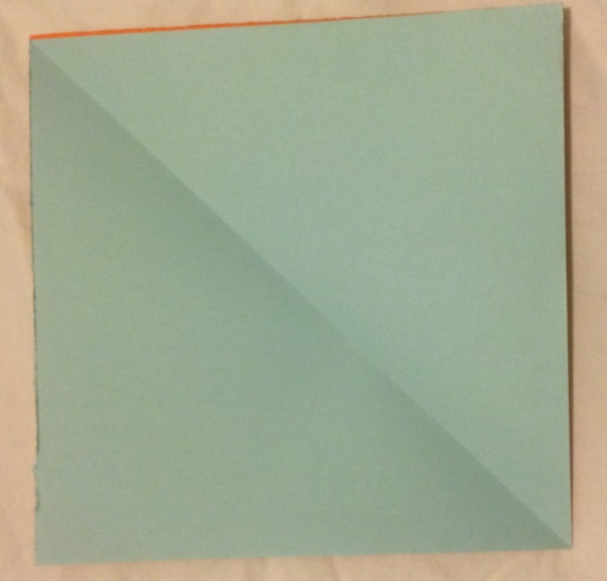
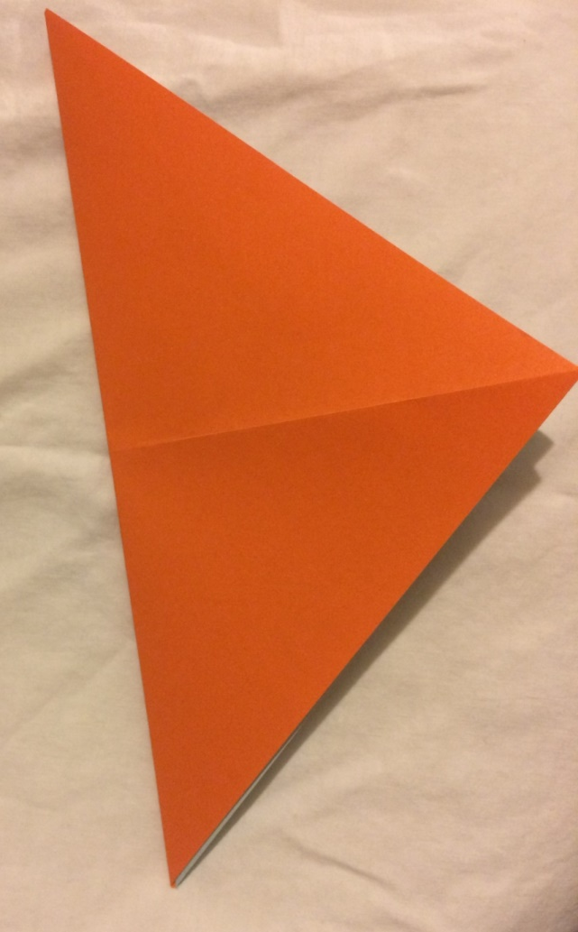
Rubbish Rebels Finger Quiz
Step 1
Fold corner to corner
Then open it back up before moving on to step 2!

Slide 2
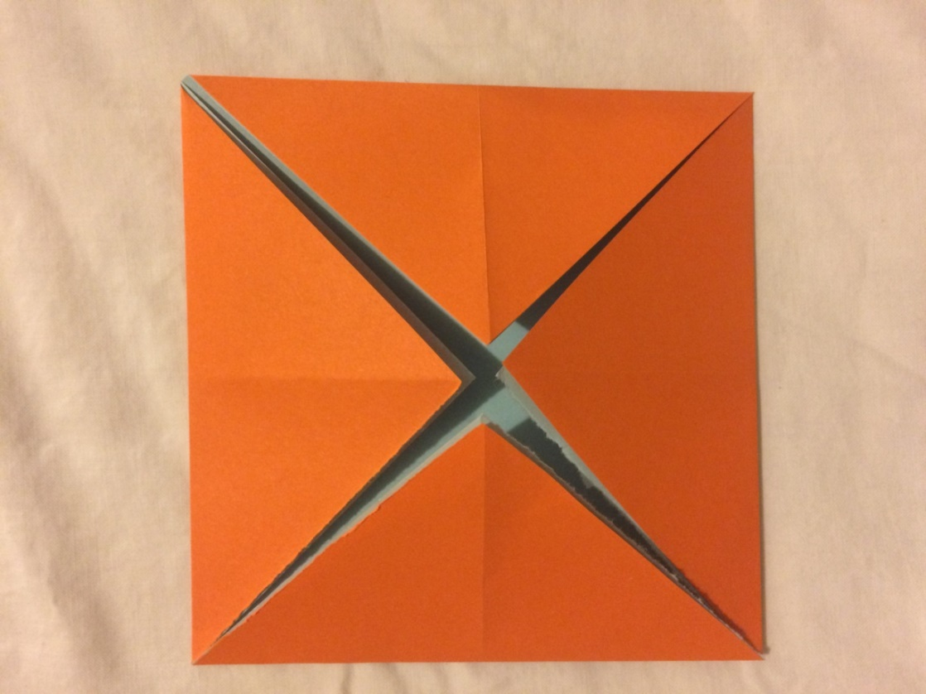
Step 2
Put the printed side down
Fold each corner to the centre

Slide 3
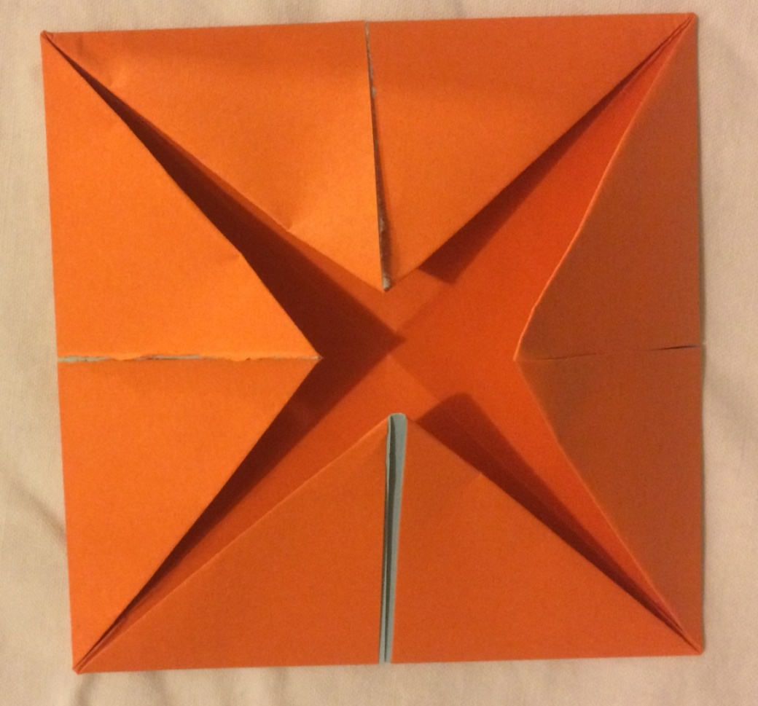
Step 3
Turn it over
Fold each corner to the centre again

Slide 4
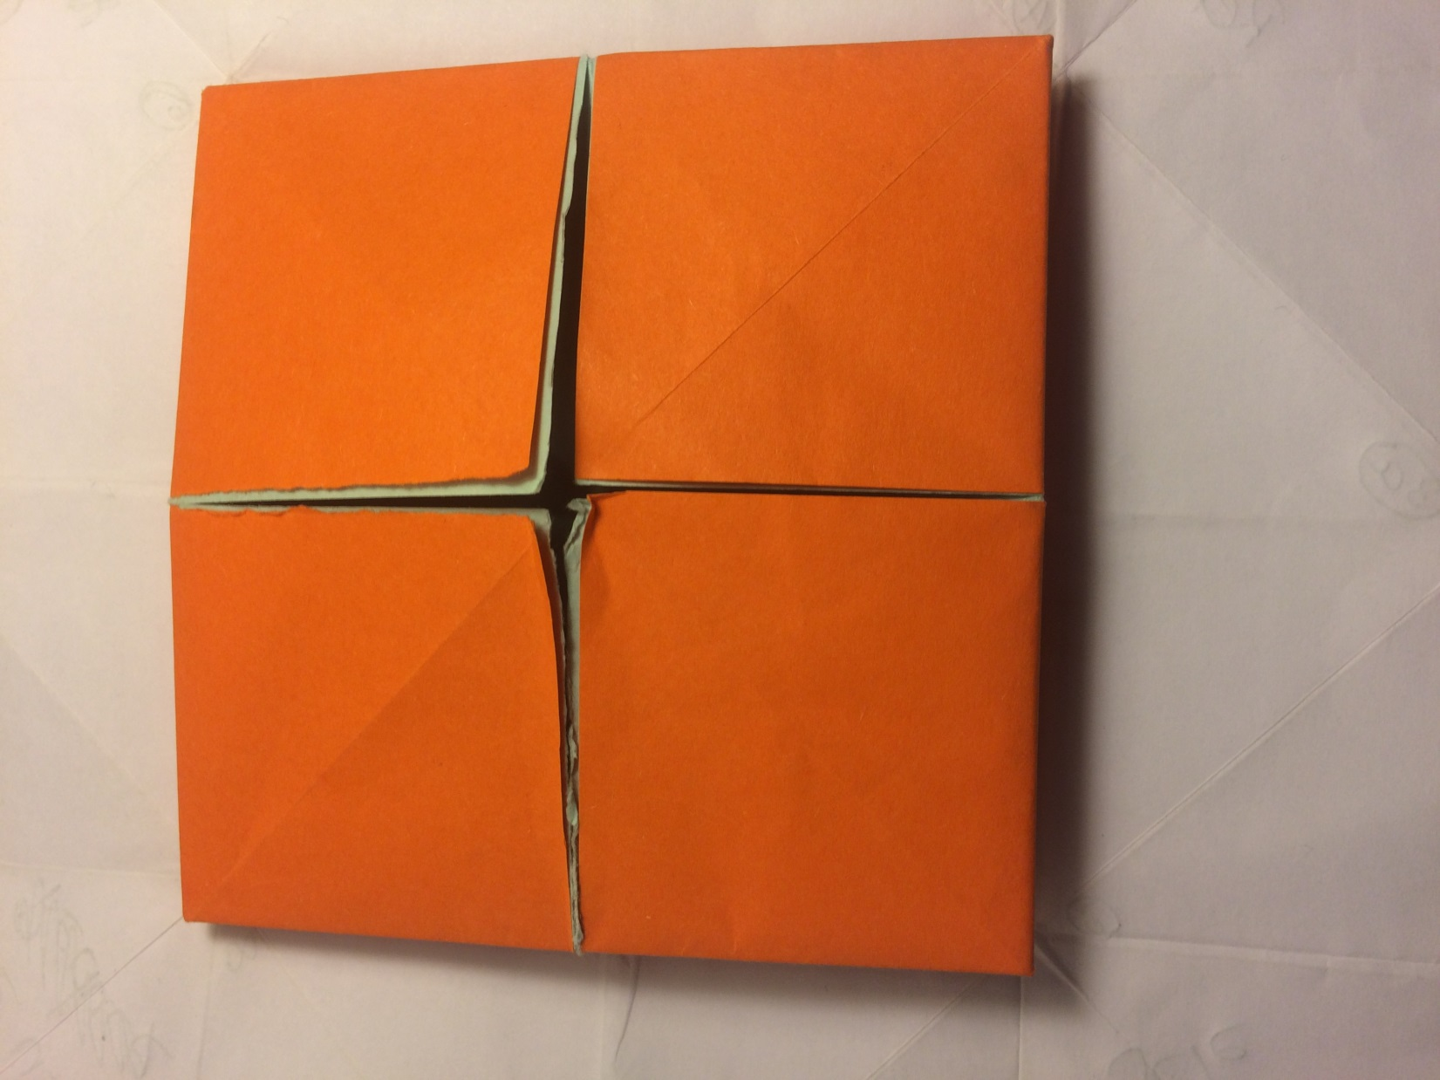
Step 4
Turn it over. You should have 4 squares like this
Fold it in half.
Fold it in half again, so it’s the size of one square

Slide 5
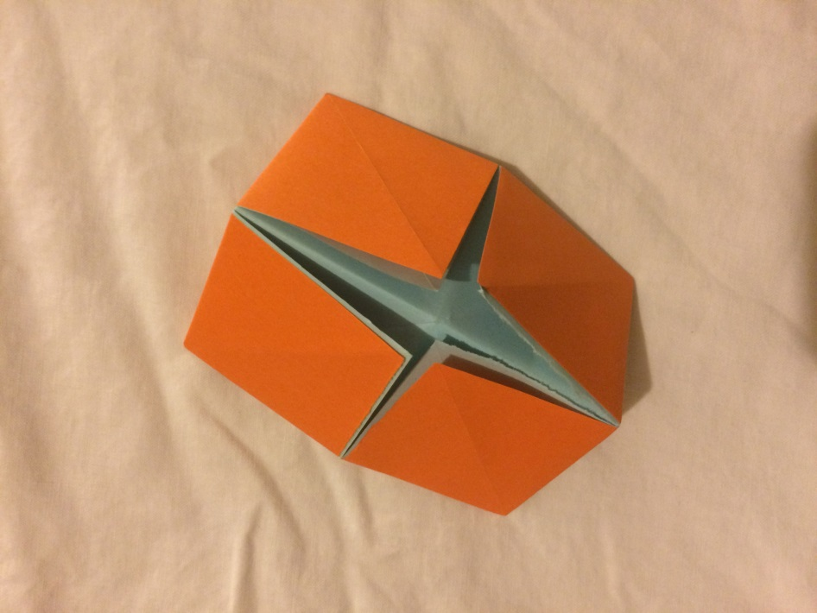
Last step! Open it back out so you have the 4 little squares like in step 4
Now put your thumbs and 1st finger under the flaps

Slide 6
