Slide 1
The Waste Hierarchy
Most favoured option
Reduce – lowering the amount of waste produced
Reuse – using materials repeatedly
Recycle – using materials to make new products
Recovery – recovering energy from waste
Landfill – safe disposal of waste to landfill
Least favoured option

Slide 2
The 4 Rs Waste Hierarchy
Most favoured option
Least favoured option
Reduce
Refuse
Reuse
Recycle

Slide 3
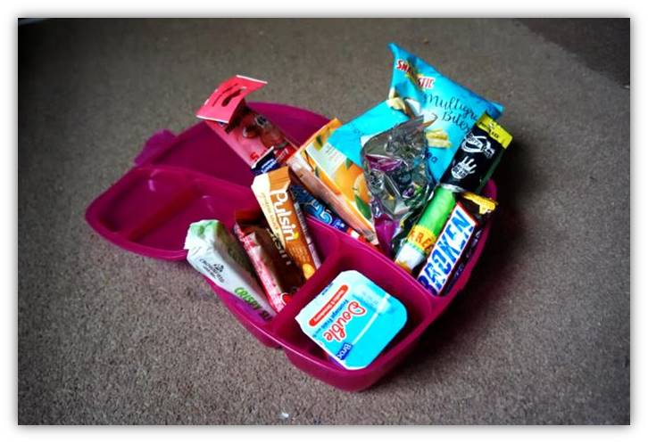
Lunchbox waste challenge
Notes:
Picture of a lunch with several excess waste wrappers, buy a big packet of biscuits and put some in a container, juice drink – make one up in a reusable drink bottle. Fresh fruit doesn’t need a wrpper.

Slide 4
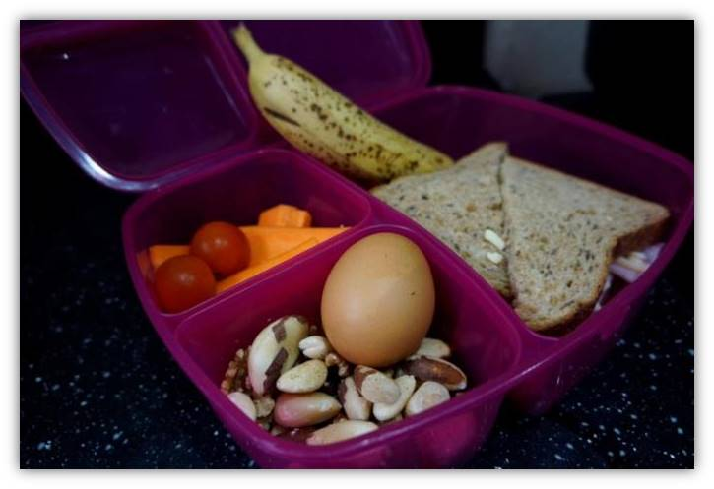
Waste-free lunch Reducing waste
Notes:
Picture of a home made lunch / picnic with minimal packaging.
Home made sandwiches so you use less packaging.

Slide 5
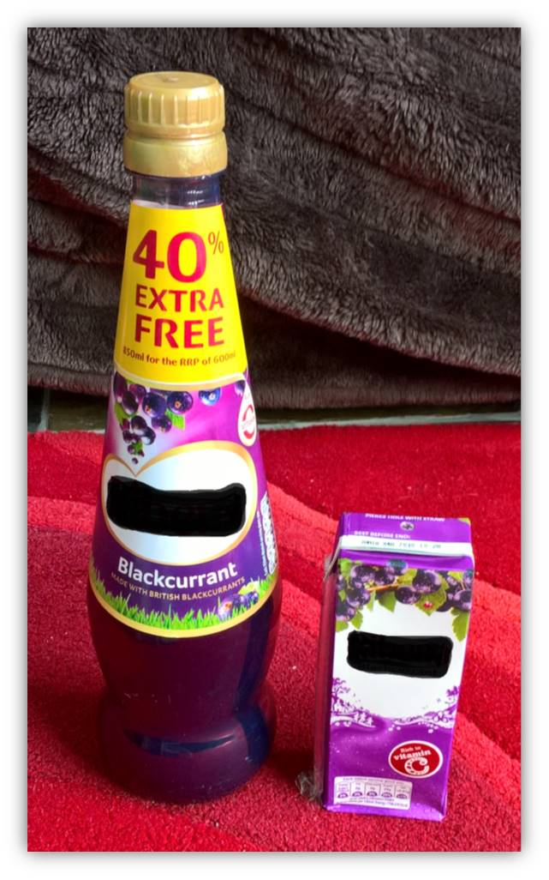
Reducing waste through smart thinking
Notes:
If you buy 1 bottle of dilute-able juice that is 850ml – how many drinks could you get out of the one bottle?
So how many small 50 ml cartons of juice would you have to buy to have the same amount of drinks and think how much more packaging there would be?

Slide 6
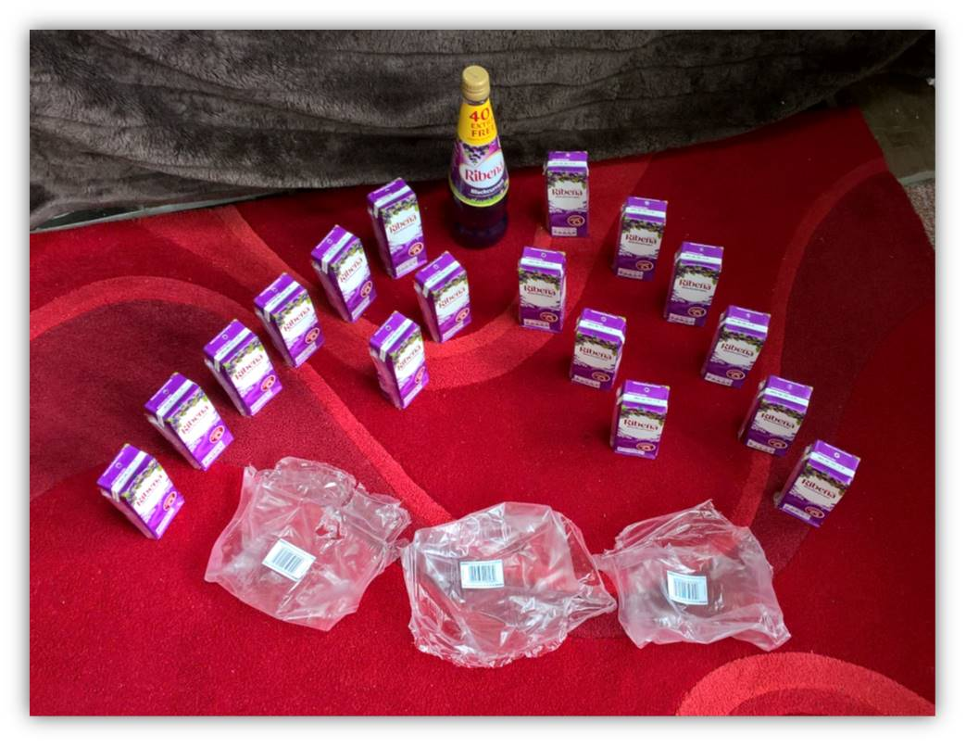
Alternative product swap 1 … to reduce waste
Notes:
17 small cartons of juice. Look how much more waste there is if you buy the small cartons!!
Can we recycle those small tetra packs in your area? If not where will they go?

Slide 7
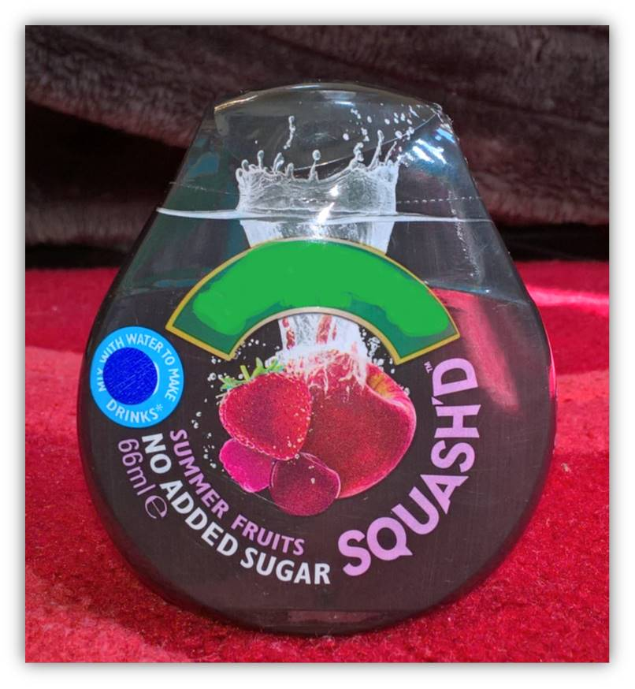
Notes:
So lets go smaller scale again with this 66ml of extra strong dilute-able juice plastic bottle.
How many drinks could we get out this? Not much excess waste on this one?

Slide 8
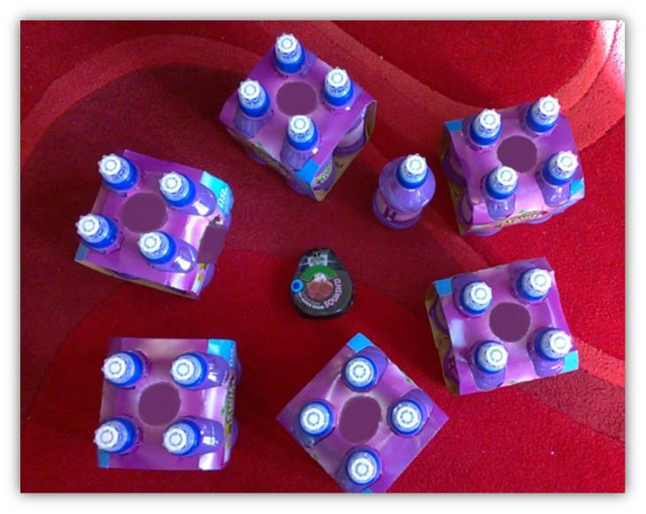
Notes:
We could get the equivalent amount of drinks in 25 small bottles, again the waste difference is huge! Cardboard cover holding the drinks together and the plastic bottles. Can this packaging be recycled?

Slide 9
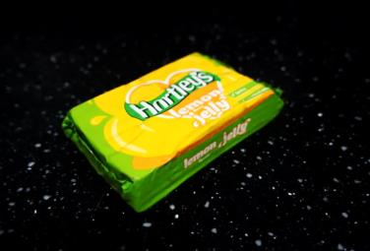
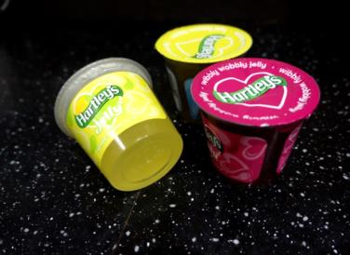
Alternative product swap 2
One block of jelly makes 568g or 1 pint of jelly.
A bought pot of jelly that’s ready to eat has 125g in it.
How many jelly pots would a jelly block make?
Notes:
How many jelly's could you make out of the jelly block and put into small reusable containers? Would this reduce the amount of packaging?

Slide 10
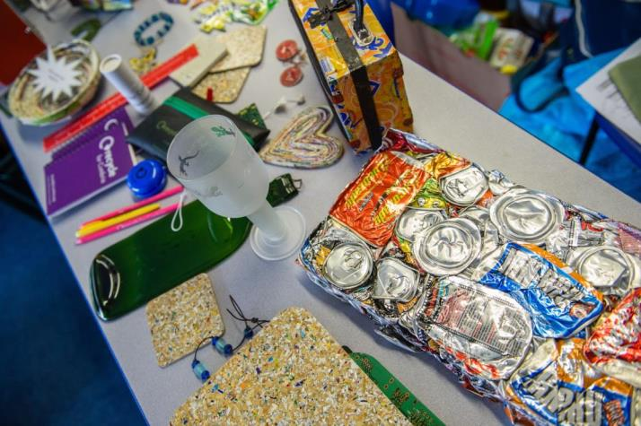
Reuseable items
Notes:
Have a look at the photo and see if you can work out what materials have been re-used?

Slide 11
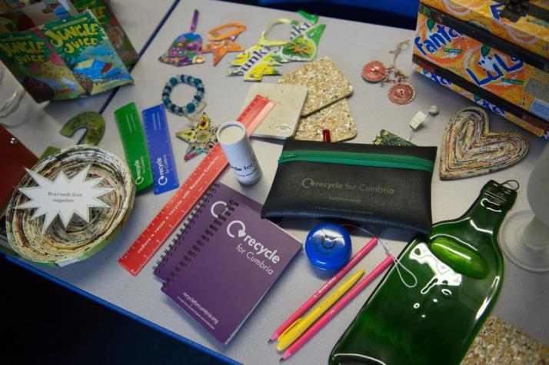
Reused items
Notes:
Black pencil case made from old tyres,
Green glass bottle heated and squashed flat,
Glass beads made into a bracelet,
Little purple note book made from recycled plastic and recycled paper.
Small square cup mats – made from recycled and melted yoghurt pots.
Heart shape made from recycled magazine pages folded up and glued together.

Slide 12
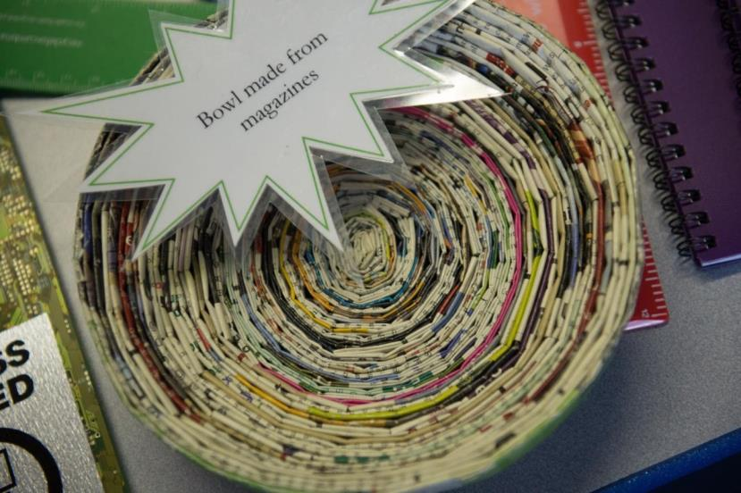

Slide 13
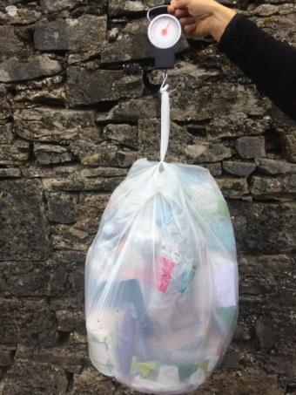
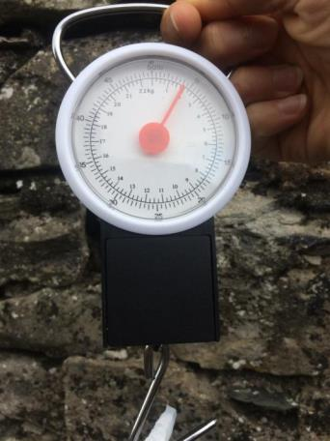
Gold award
Weighing waste bags

